Slide 1




StudyMate
Your 24/7 AI Study Survival Buddy
Logo:

Slide 2


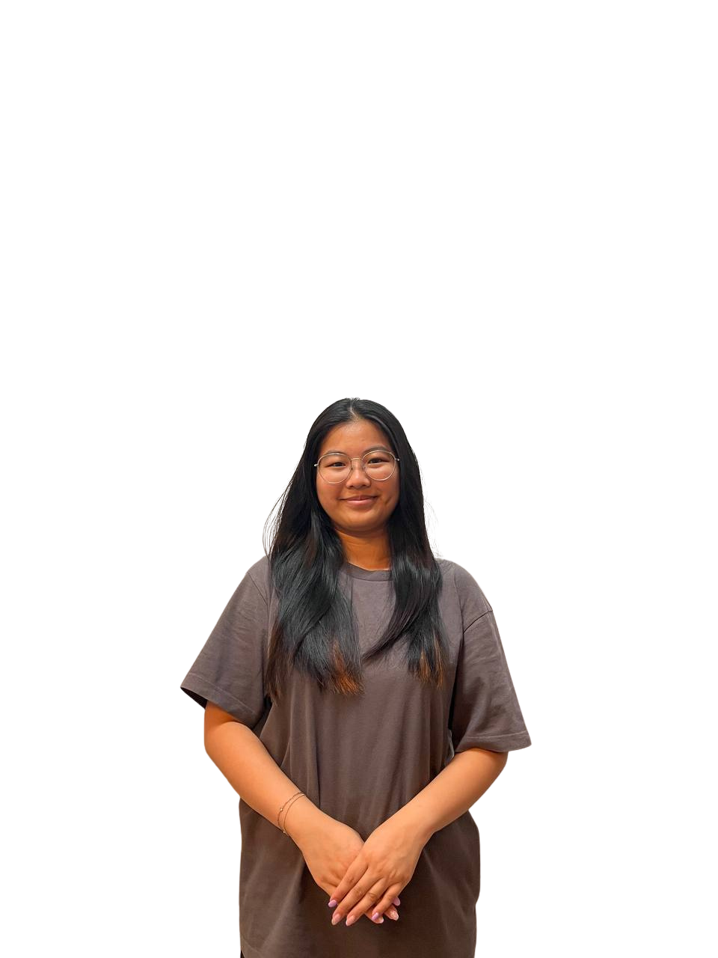


1
Introduction of the team
Keshini
Danica
Adel
Durka
Pei Xuan
AI Builder
Writer
Designer
Data Curator
Coordinator

Slide 3

Keshini
1
AI Builder
As the AI Builder for the StudyMate project, my primary responsibility was to design and implement the chatbot logic using Botpress and Flowise. I focused on developing structured and modular conversation flows to support key features such as the Pomodoro study planner, motivational check-ins, academic Q&A, and deadline reminders.
I also worked on prompt design and optimization, ensuring that user interactions were clear, relevant, and helpful. In addition, I conducted multiple rounds of testing and refinement to improve response accuracy, usability, and overall user experience. This role required close collaboration with both the data curator and design team to align the chatbot’s content and functionality with the needs of our target audience.
Through this role, I gained hands-on experience in prompt engineering, AI workflow design, and integrating AI tools into practical, student-focused solutions.

Slide 4
Danica
1
Writer
In this project, I took on the role of writer. My main responsibilities included drafting and refining key sections of the final report to ensure that our findings and insights were clearly communicated and professionally presented. I also played a central role in building the presentation slide deck, where I focused on both content development and visual consistency. As part of the QA process, I reviewed the entire deck to ensure accuracy, flow, and alignment with our report. In addition, I was in charge of documenting testing insights, which involved analyzing test outcomes and organizing them into clear, actionable summaries. Throughout the project, I made use of tools such as Microsoft Word for report writing, PowerPoint for slide development, and Canva for enhanced visuals. My goal was to maintain high standards in both written and visual deliverables while supporting the team in delivering a cohesive and impactful presentation.

Slide 5
1
Durka
Data Curator
I am dedicated to leveraging technology to enhance students’ academic experience by addressing common challenges such as time management and study-related stress. In this project, I serve as the Data/RAG Lead, responsible for curating and structuring academic content into clear, concise question-and-answer formats that enable the AI chatbot to deliver accurate and relevant responses. Additionally, I contribute to testing the chatbot’s functionality and assist in developing visual materials for the final report and presentation. This role allows me to apply my skills in data management and AI integration to create an effective and supportive study tool for my peers.

Slide 6
1
Pei Xuan
Coordinator
In this project, I serve as the Coordinator, responsible for overseeing the overall workflow, ensuring timely task completion, and maintaining clear communication within the team. My role involves organizing project documentation, consolidating contributions from all members, and ensuring alignment across different task areas.
I am primarily responsible for developing and structuring the project’s webpage, ensuring that it clearly communicates our objectives, features, and outcomes in a user-friendly manner. In addition, I actively contribute to building the chatbot by supporting its content development and refining its interaction flow.
This role allows me to apply my strengths in web development, user experience, and communication to contribute meaningfully to the project’s success.

Slide 7
1
Adel Cheng
Designer
As part of the team, I am responsible for leading the development of StudyMate’s visual branding and overseeing tool integration and testing. This includes designing the platform’s logo, UI mockups, and explainer graphics using tools such as Canva. I work closely with the team to ensure that the visual identity aligns with our overall goals and that all integrated tools function smoothly throughout the development process.

Slide 8


2
Problem definition, Solution & Target audience
Introduction to our project.

Slide 9

The Problem
Today’s students often feel overwhelmed by the sheer amount of information they’re required to absorb and retain across multiple subjects. Outside of scheduled lessons or tutoring sessions, access to academic support is limited. Many lack the time or resources to hire private tutors, and traditional study methods can be inefficient. The challenge is clear: students need quick, reliable, and accessible help, especially during late-night study sessions.

Slide 10
Our Solution
StudyMate solves this problem by offering an AI chatbot that operates as a 24/7 Q&A assistant. Students can type in any module-related question and receive an instant, understandable response. Whether they’re stuck on a definition, concept, or problem-solving step, StudyMate is always available to help them move forward in their learning.

Slide 11
Target Audience
Our main users are polytechnic and university students, typically aged 17 to 25. These learners are digital-first, comfortable with chat interfaces, and constantly multitasking between modules. StudyMate provides them with a fast, convenient way to get answers without having to wait for formal consultation sessions or rely on forums with unreliable replies.

Slide 12
3
How it works & Tools we use
A guide to StudyMate’s website

Slide 13
User Flow
Using StudyMate is simple and intuitive. A student opens the chatbot and types in a question. Be it from a worksheet, textbook, or lecture slide. The question is processed by our AI model, which replies with a clear, step-by-step explanation. The entire process feels conversational and responsive, making learning less stressful and more interactive.

Slide 14
Technology behind StudyMate
StudyMate was developed using Flowise, a visual interface for building AI chatbots without the need for complex backend programming. We used Visual Studio Code and GitHub Copilot to manage our codebase and speed up prompt development. Canva was used for branding, UI mockups, and marketing materials, ensuring a consistent and student-friendly visual experience.

Slide 15
4
Key features & Marketing techniques
What’s special about StudyMate?

Slide 16
Key Features
StudyMate specializes in one powerful feature:
Instant academic Q&A. The chatbot answers questions clearly and accurately, with explanations tailored for student understanding. It’s especially useful for reviewing lecture content, clarifying terminology, or checking answers to practice questions. While summarisation features were planned, our current release focuses fully on refining this core Q&A capability.

Slide 17

Marketing techniques
To promote StudyMate and ensure it resonates with our target users, we created several digital marketing assets using Canva. These include a clean, student-friendly logo that reflects the platform’s identity as a smart, reliable study buddy. We also designed a series of social media graphics suitable for Instagram and LinkedIn, highlighting StudyMate’s key features and benefits in a visually engaging format.

Slide 18
Marketing techniques
In addition, we created UI mockups to demonstrate what users can expect when interacting with the chatbot. These visuals played a crucial role in pitching StudyMate during our presentations and user demos. We also developed explainer graphics that outline how to use the chatbot step-by-step, helping to guide first-time users.
These assets helped us communicate the value of StudyMate effectively and professionally, especially in academic and project showcases.

Slide 19
5
Our challenges & Future developments
Challenges we faced and what we plan to enhance

Slide 20
9
Challenges we faced
Developing StudyMate came with its own set of challenges. Crafting prompts that produce accurate, helpful answers required trial and error. Working with Flowise was new to us, but it allowed for a low-code development approach that simplified the overall process. Copilot supported faster coding, but careful human judgment was essential. Through peer testing, we gained insights into how students interact with the bot and how to improve its tone and clarity.

Slide 21
10
Future developments
Looking ahead, our goal is to continue improving StudyMate’s accuracy and expand its understanding across more subject areas. We plan to gather more user feedback, implement confidence-based response indicators, and explore integrations with campus learning portals. Eventually, we hope to reintroduce summarisation and flashcard generation as additional features. With further testing and stakeholder input, StudyMate can evolve into a go-to academic support tool for students everywhere.

Slide 22
StudyMate | Team Penguin
Thank you!
Thank you for taking the time to learn about StudyMate. We’re excited about its potential to help students learn more effectively, and we welcome your feedback, questions, or collaboration.
~ Adel, Danica, Durka, Keshini & Pei Xuan

